Slide 1
Introduction to yabadaba
Lucas Hale

Slide 2
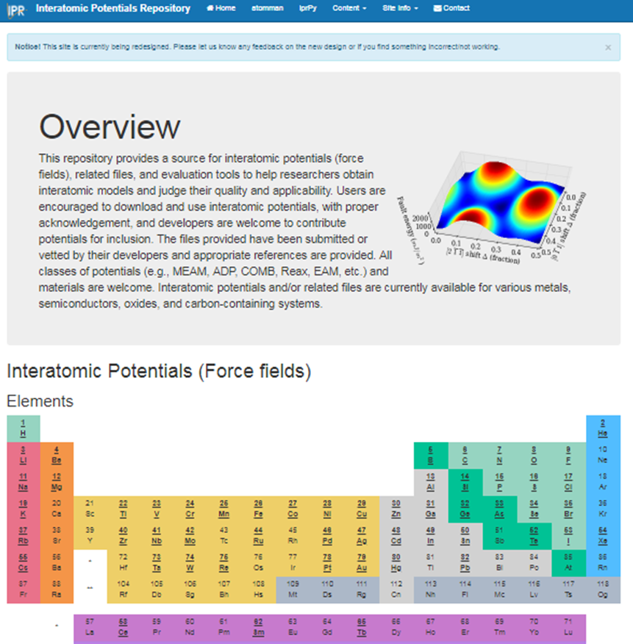
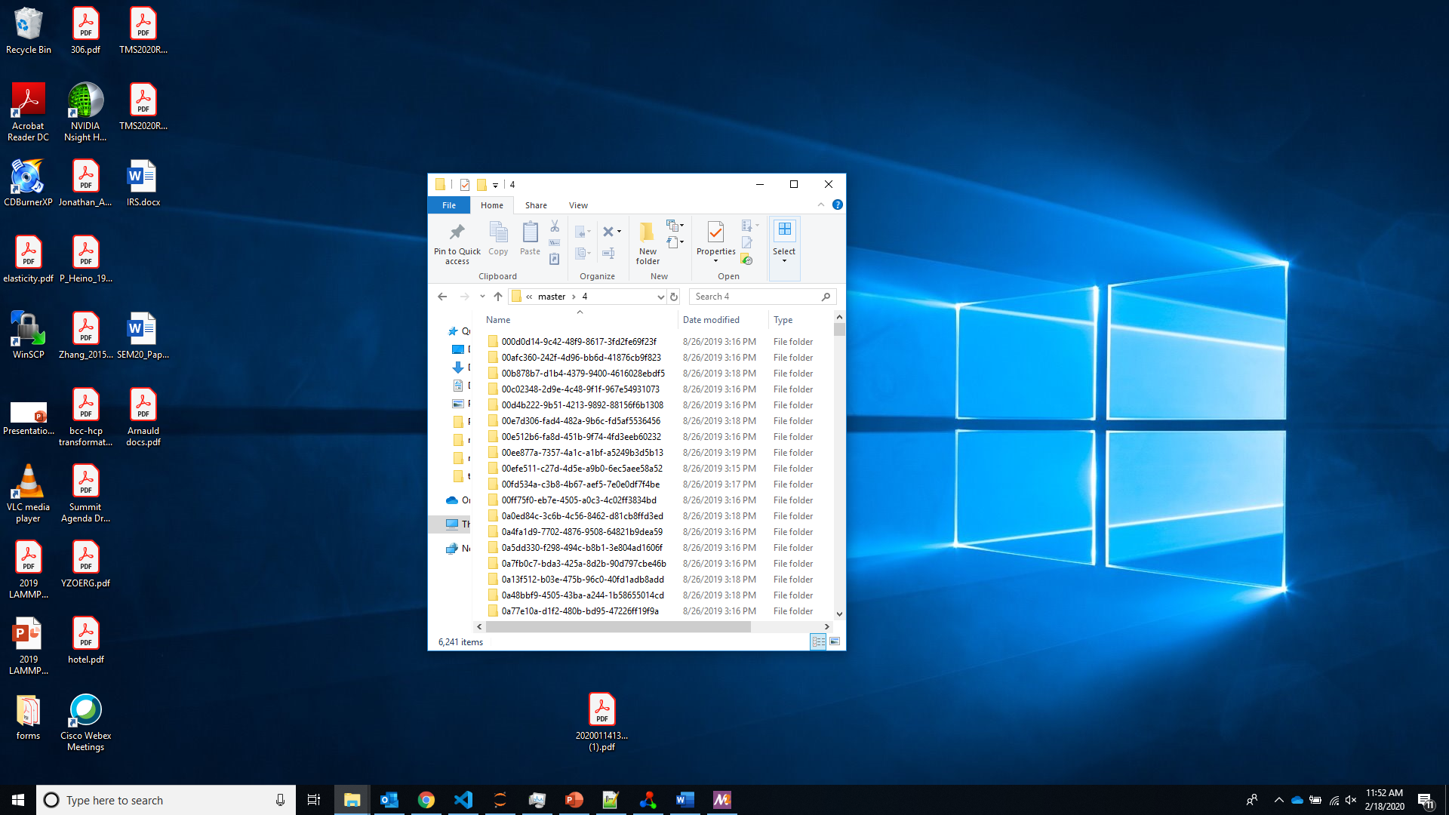
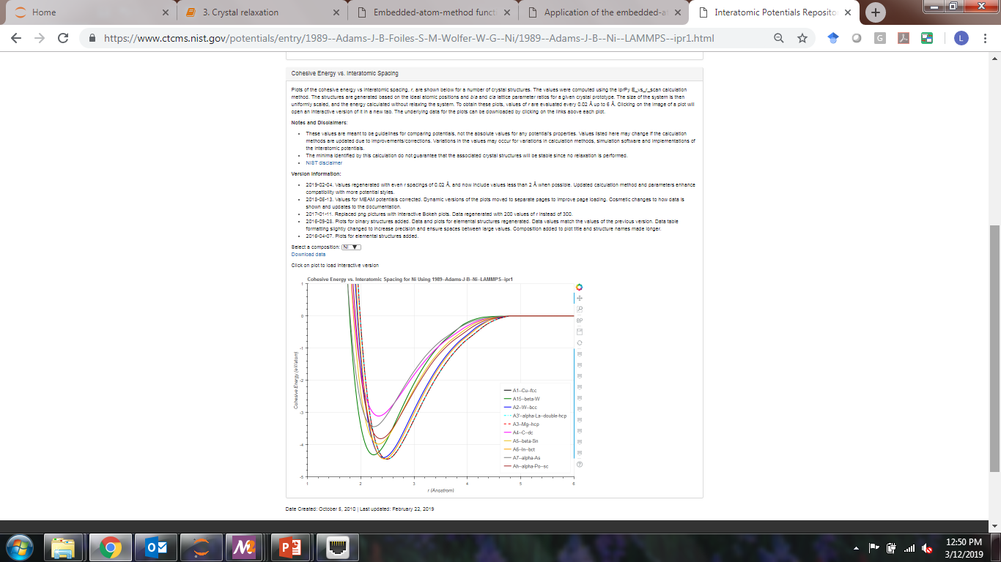
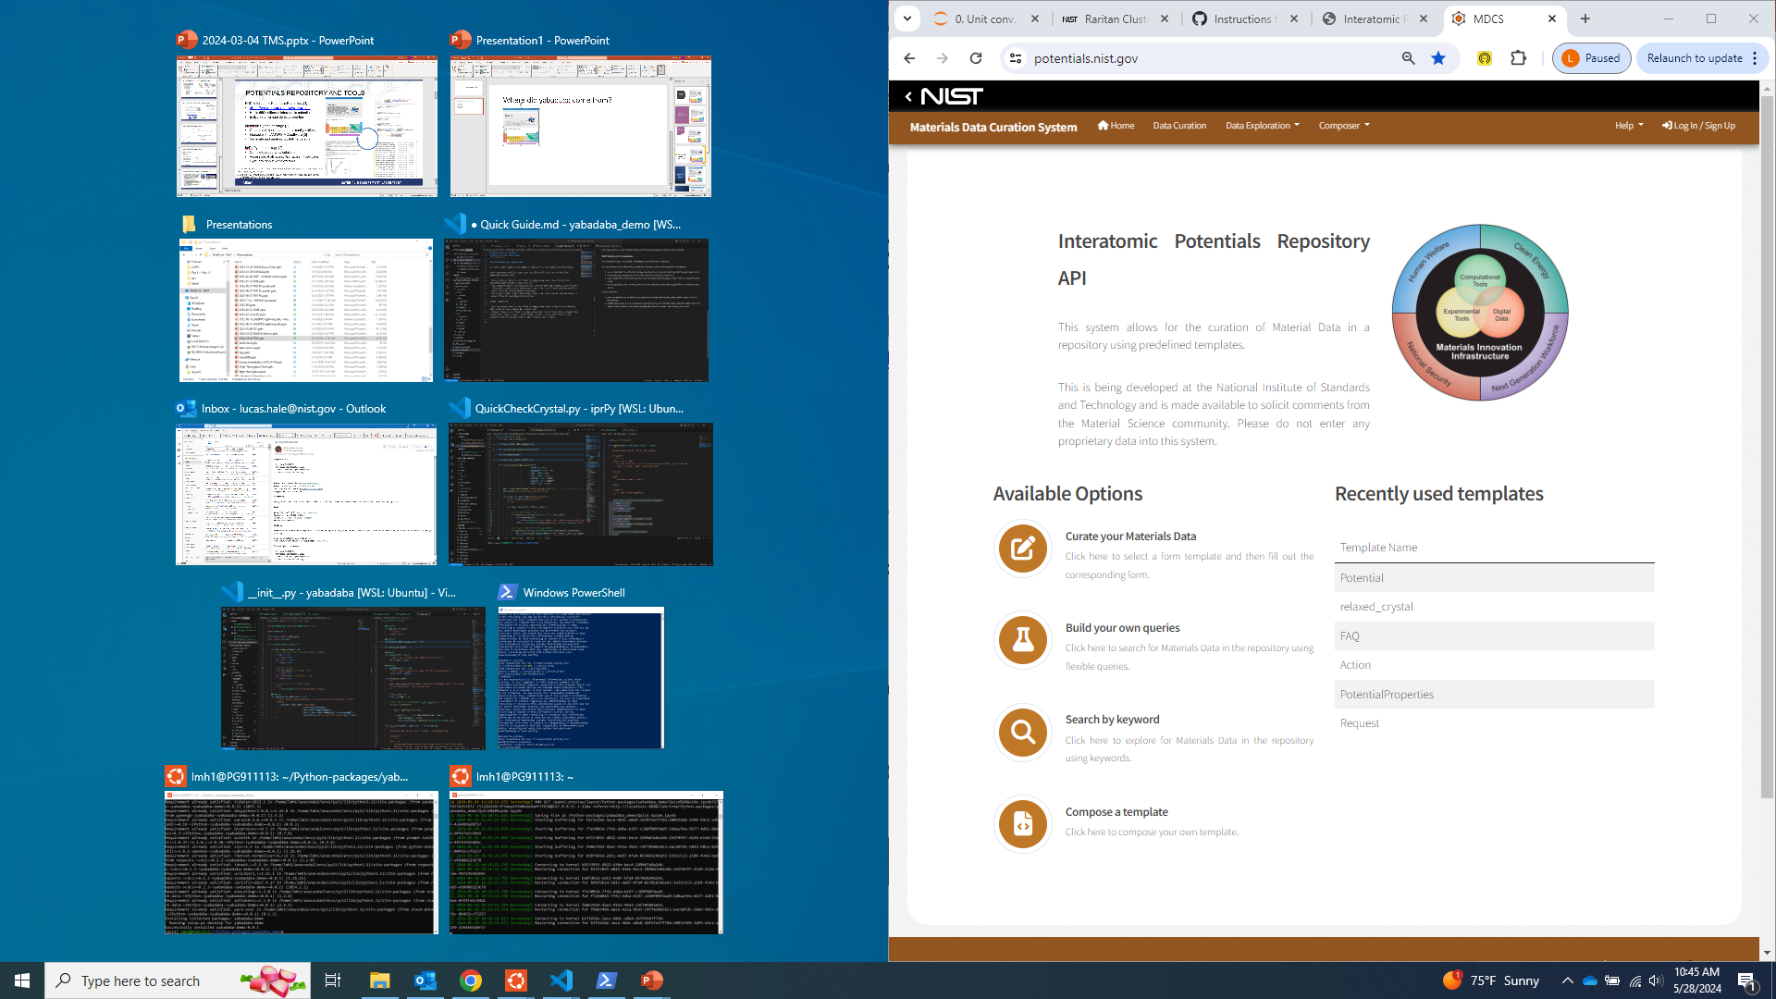
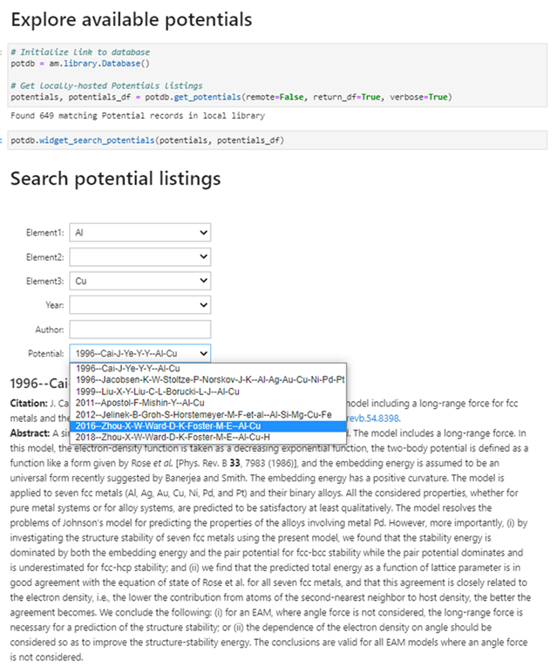
Origin story of yabadaba
Interatomic Potentials Repository
Interatomic Potentials Repository (IPR) static website
IPR content migrated to MDCS/CDCS curator backend
High throughput infrastructure developed to evaluate potentials and add results to the IPR website
potentials Python API package created to provide user-friendly interface to IPR content via CDCS.
Realization that potentials API and high throughput workflow were doing similar database operations
The core database interactions extracted as yabadaba!
High throughput calculations
Results on IPR website
potentials.nist.gov curator
potentials Python API
yabadaba!

Slide 3


Is FAIR good enough?
Classic data
Focus on application
Software interprets data to be accessible
FAIR data
Focus on data longevity
FAIR outlines database accessibility
Software
Data
Users of FAIR data should not have to be experts in databases and data record parsing.
Data generators are experts in their data and should release open-source APIs for it.
How can we make it easier for generators to develop user-friendly APIs for FAIR data?

Slide 4
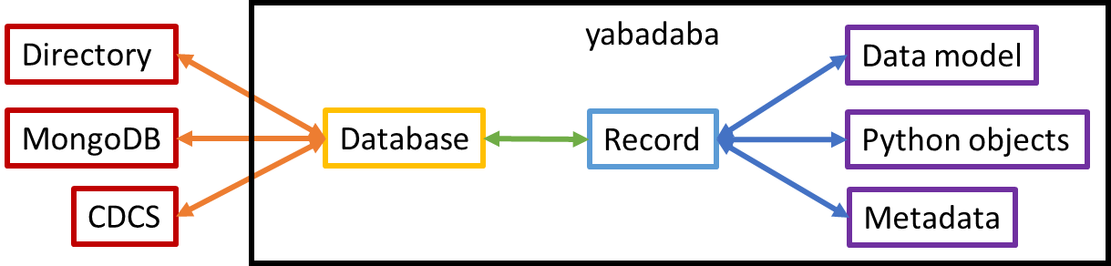
yabadaba: Yay! A Base Database!
https://github.com/usnistgov/yabadaba
Mid-level abstraction layer for data and database interactions
Allows developers to design code for their data rather than the database infrastructure
Allows users to access the data without needing to be database experts

Slide 5
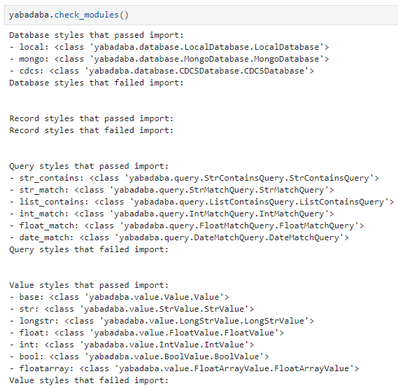
Modular components of yabadaba
Databases provide common interaction methods to different database infrastructures
Records interpret specific data schemas and make the data accessible to users
Queries define how basic database queries can be efficiently performed with the different databases
Values manage the transformations of record values between different representations

Slide 6
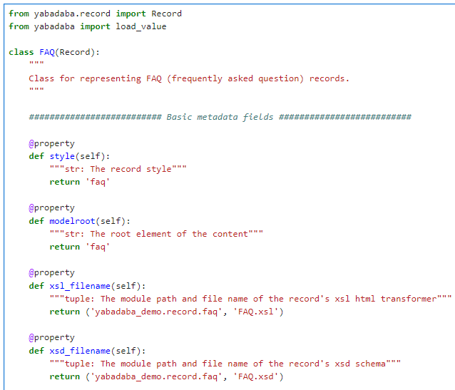
Example Record: FAQ
Import Record and load_value from yabadaba
FAQ is a subclass of Record
Basic metadata fields
“style” is the internal record style/template/schema name
“modelroot” is what the singular root element of the JSON/XML representation is called
“xsl_filename” optionally specifies an XSL transformation for the XML representation
“xsd_filename” optionally specifies an XSD schema for the XML representation

Slide 7
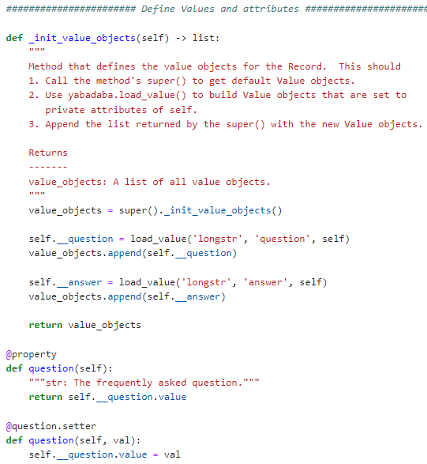
Example Record: FAQ part 2
_init_value_objects defines values for the Record
Call its super() to get value_objects
Use load_value() to define values and metadata associated with them
Save the Value objects as __private variables
Append value_objects with the defined Values
Return value_objects
Define property and setter for each Value that points to their .value

Slide 8
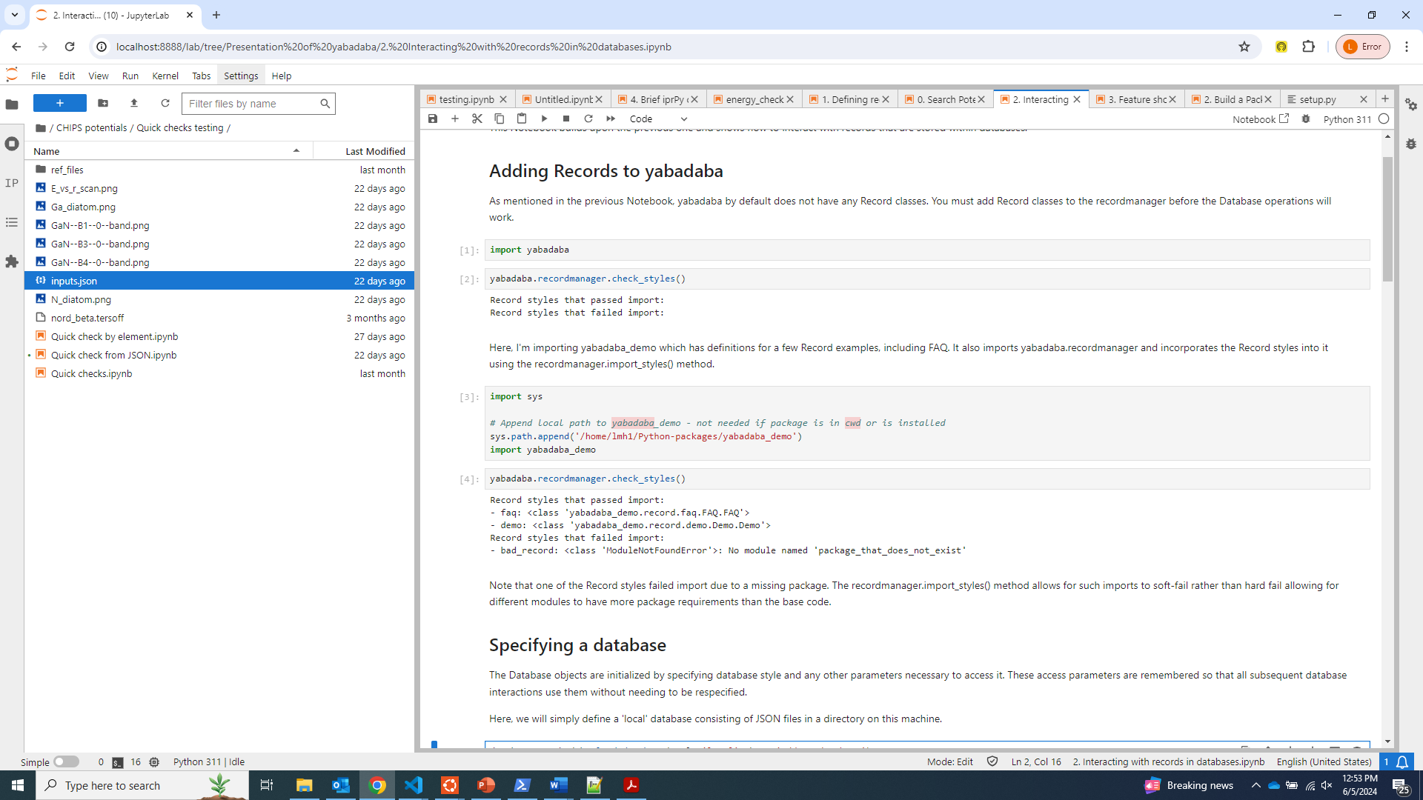
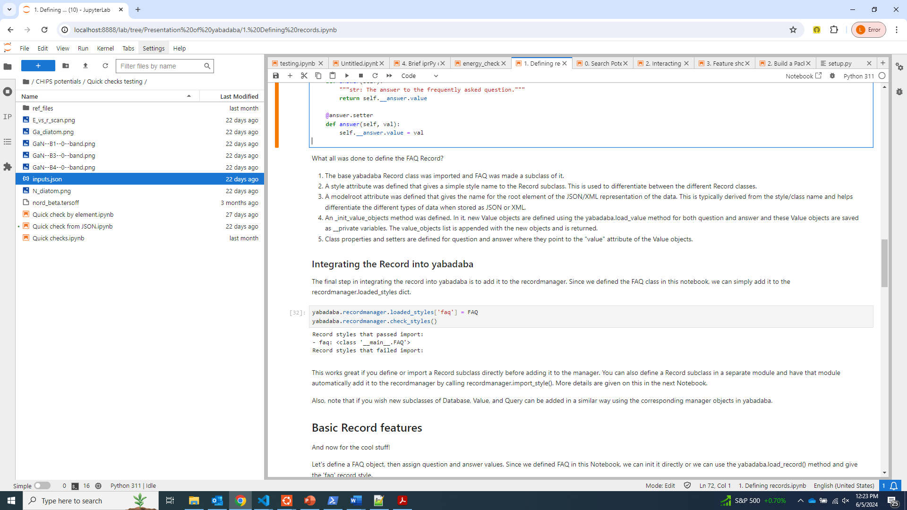
Incorporate Record into yabadaba
Define Records in a separate package that adds them to recordmanager
Directly add Record to recordmanager

Slide 9
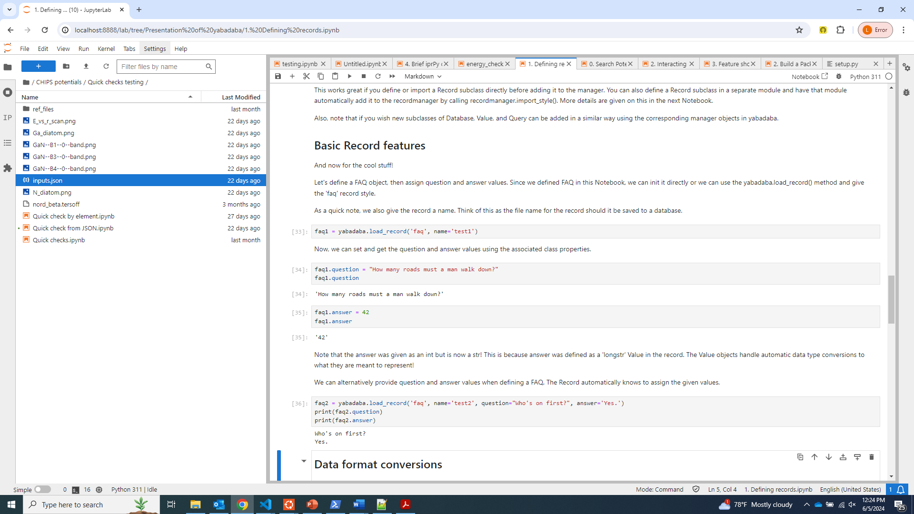
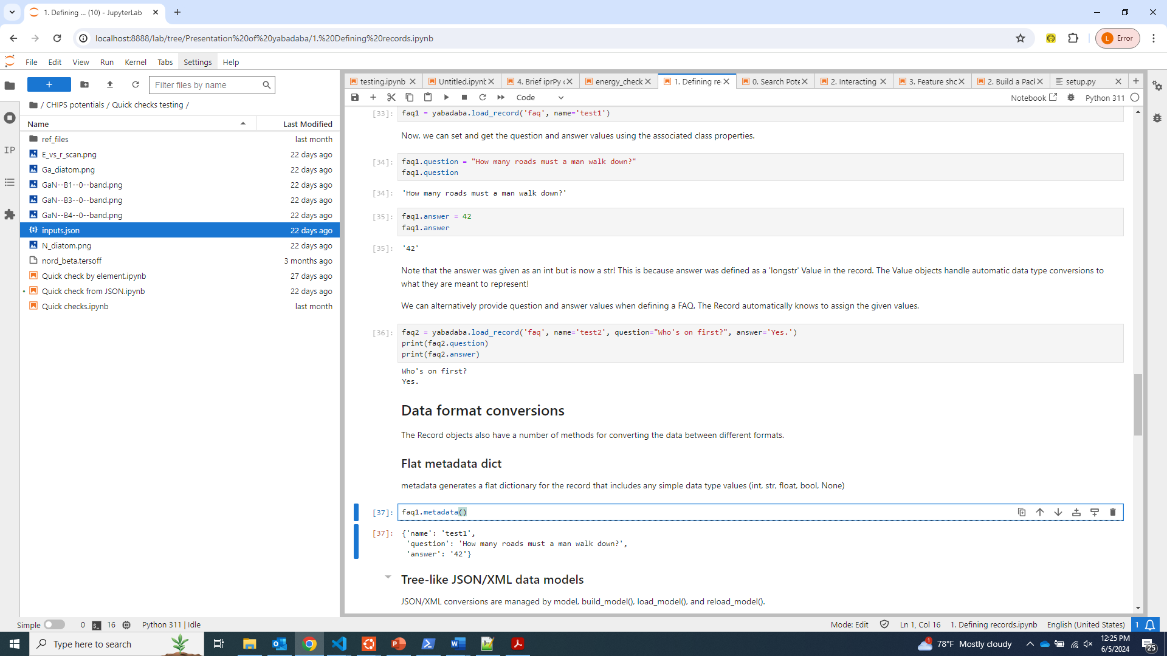
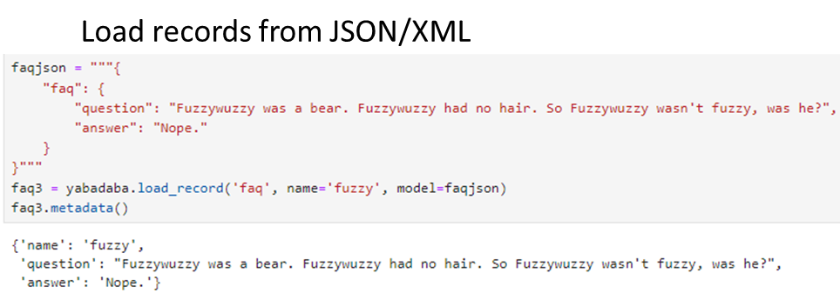
Initializing Records
Call load_record(), set values afterwards
Set values when calling load_record()

Slide 10
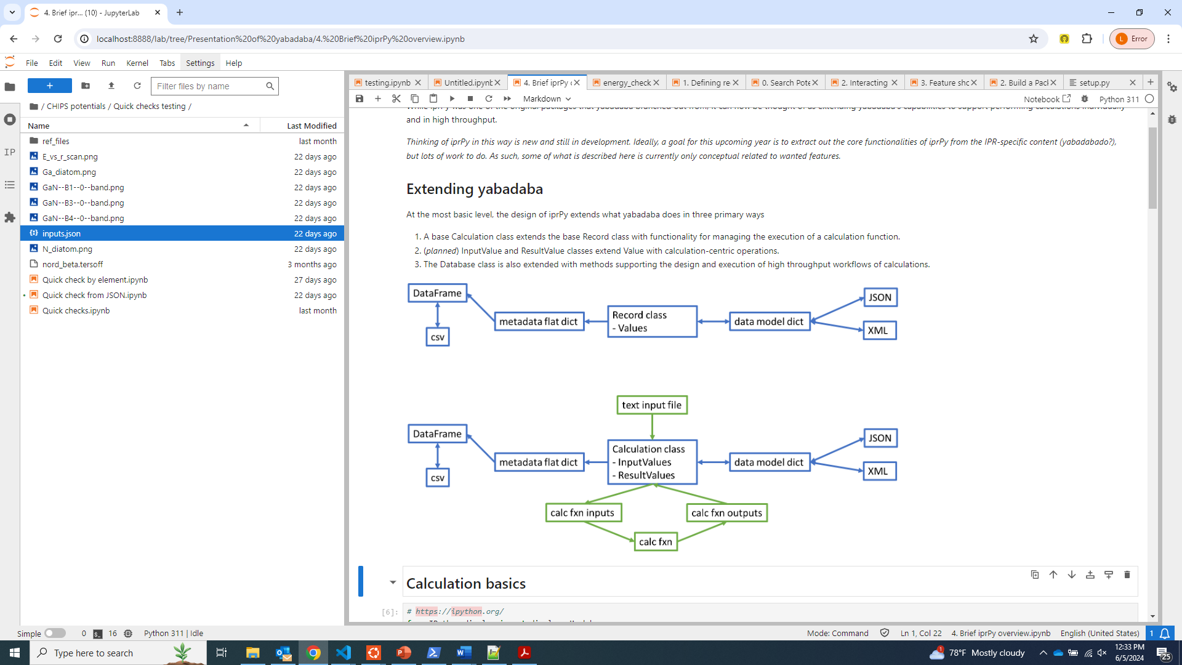
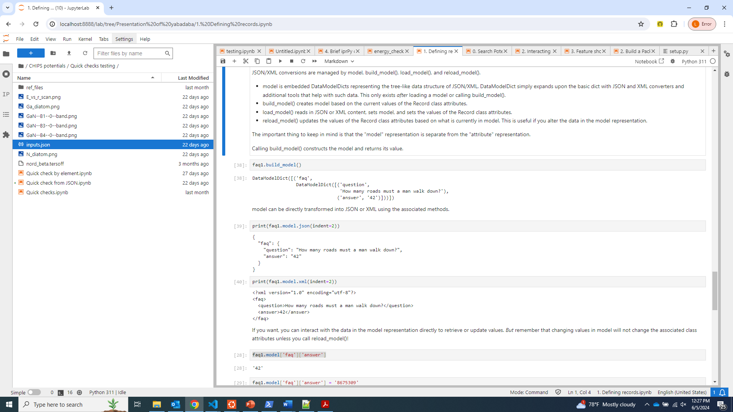
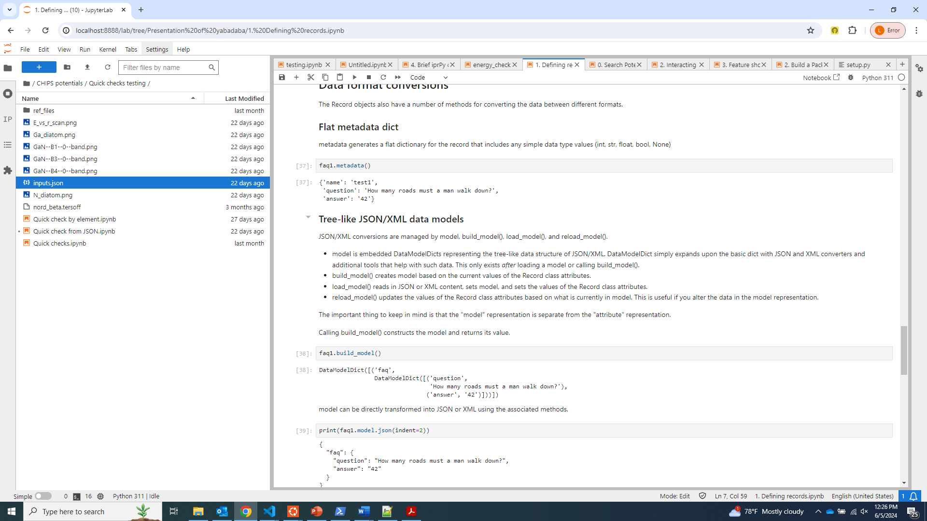
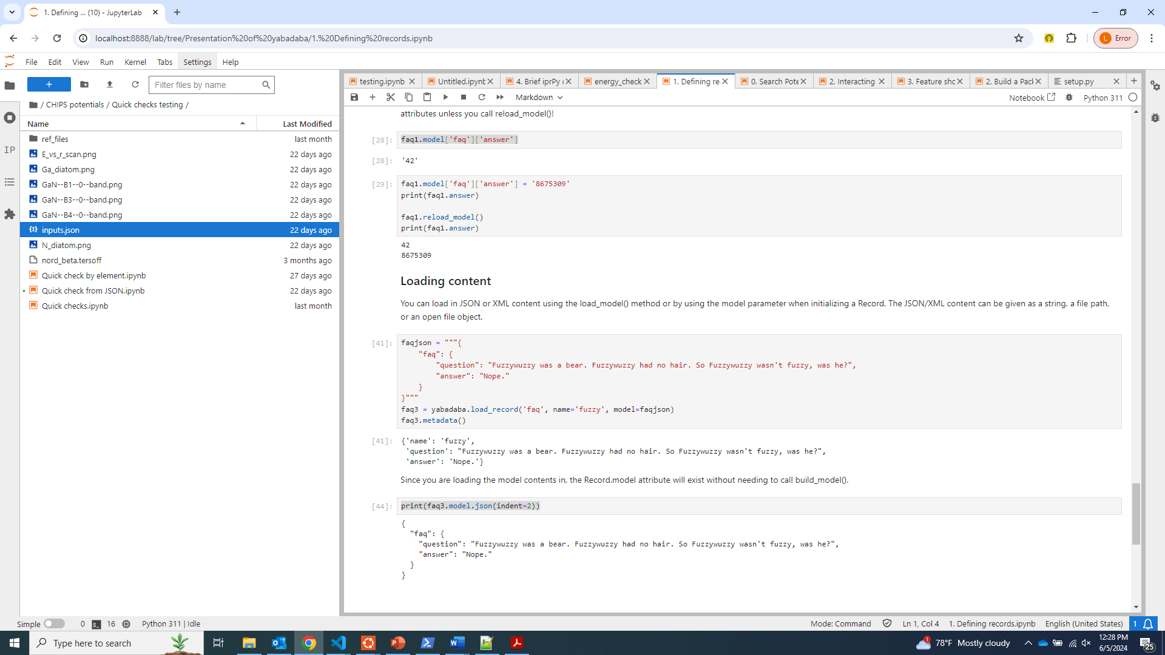
Record data transformations
Model is complete data model for the record
Metadata is flat dict of simple data
Convert model to/from JSON/XML
Directly modify model, update class values

Slide 11
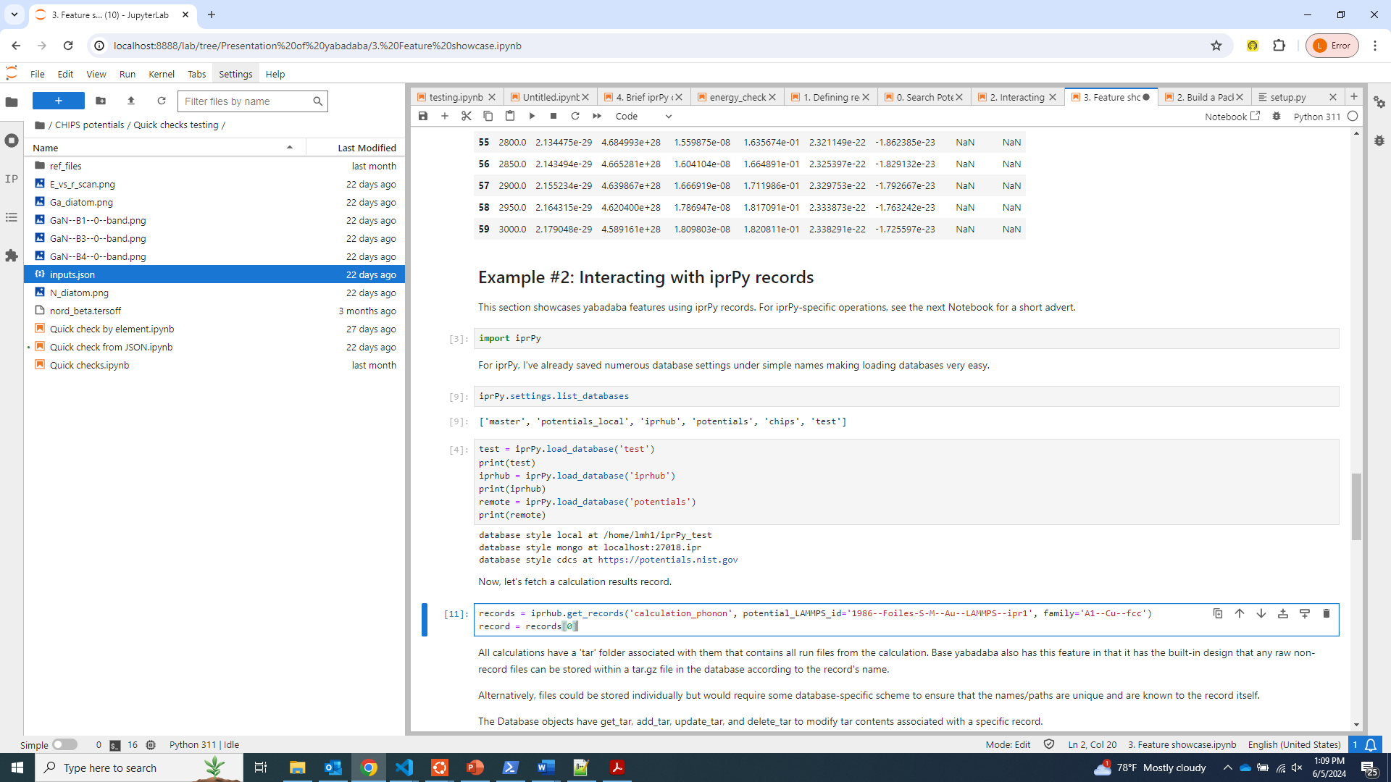
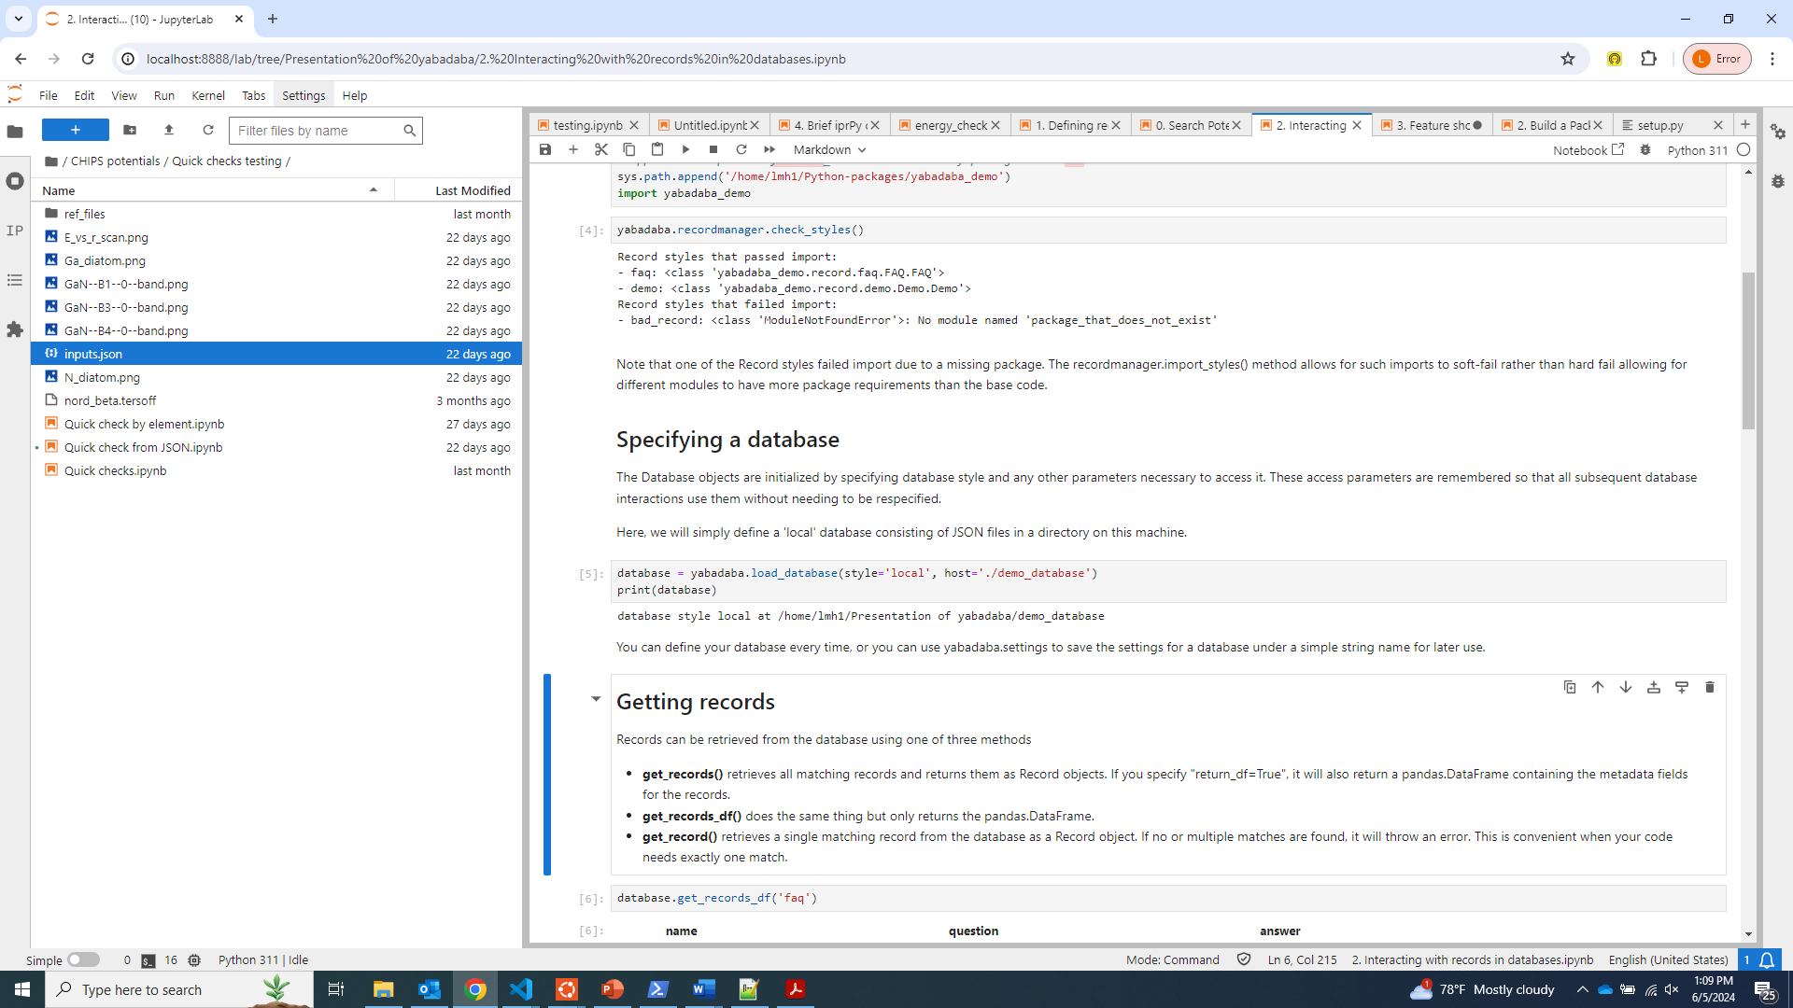
Initialize database connections
Load pre-defined access parameter settings
Manually specify style and access parameters

Slide 12
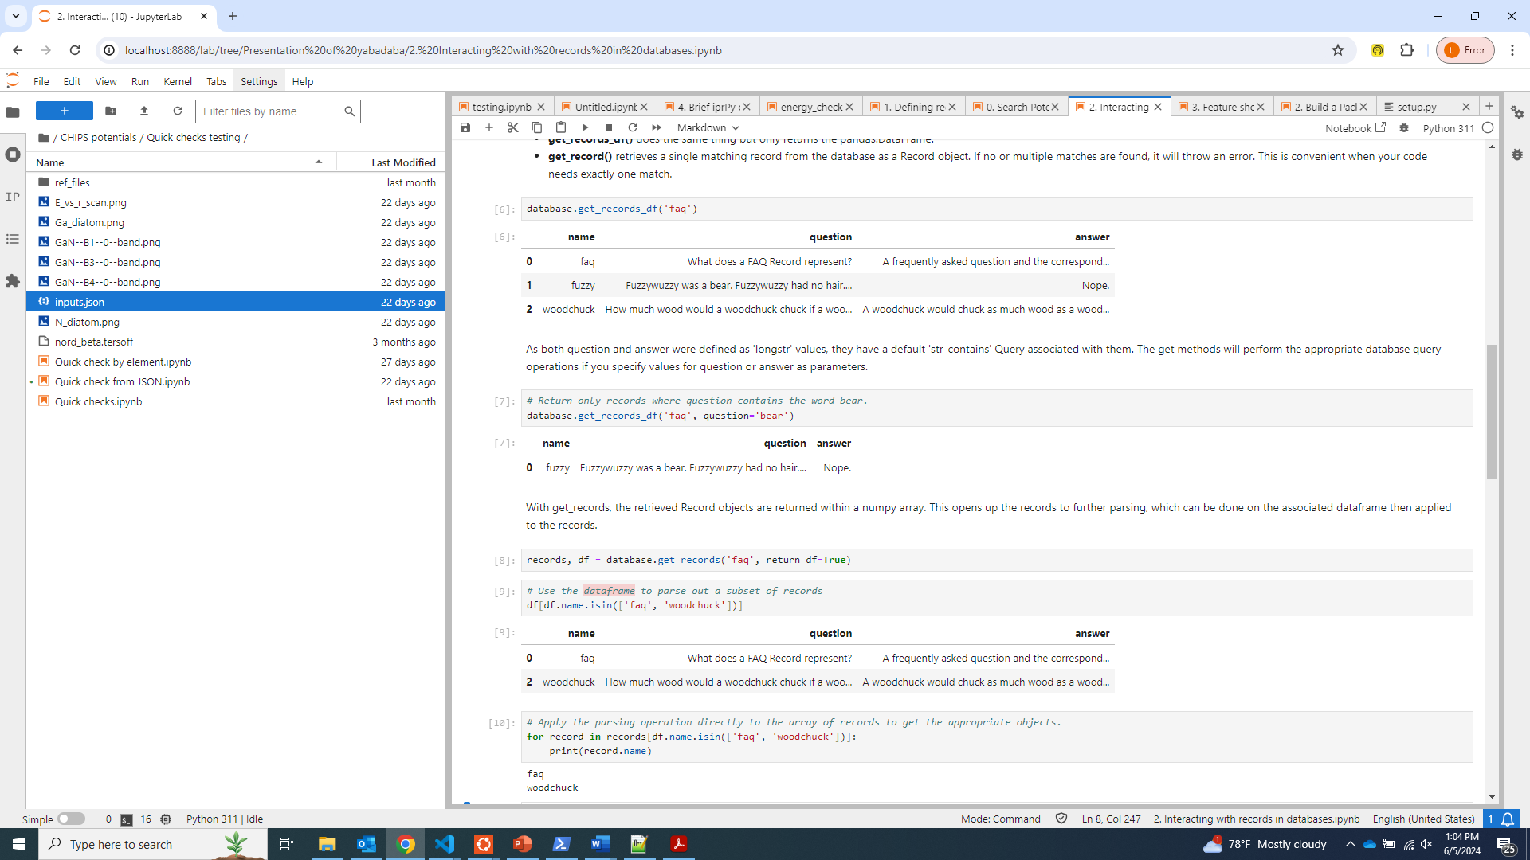
Query records
Get all records of a given style
get_records() returns all matching record objects
get_records_df() returns metadata for all matching records
get_record() returns one matching record, error otherwise
Post-query filtering on df can be applied to the array of record objects
Extra parameters use the default query operation of the corresponding Value’s style

Slide 13
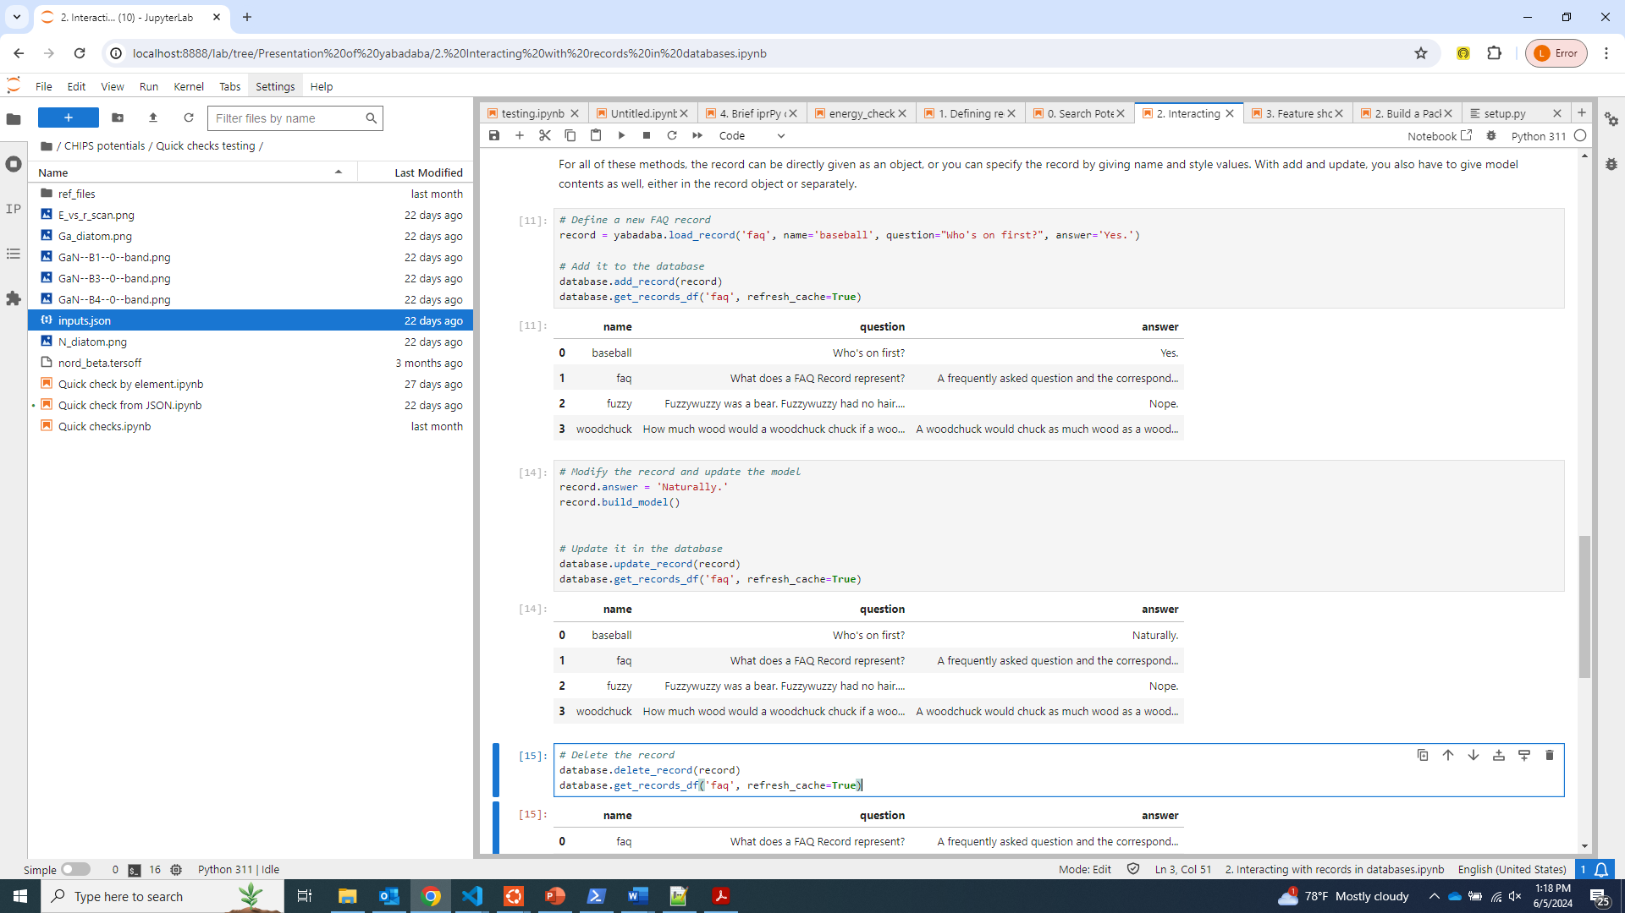
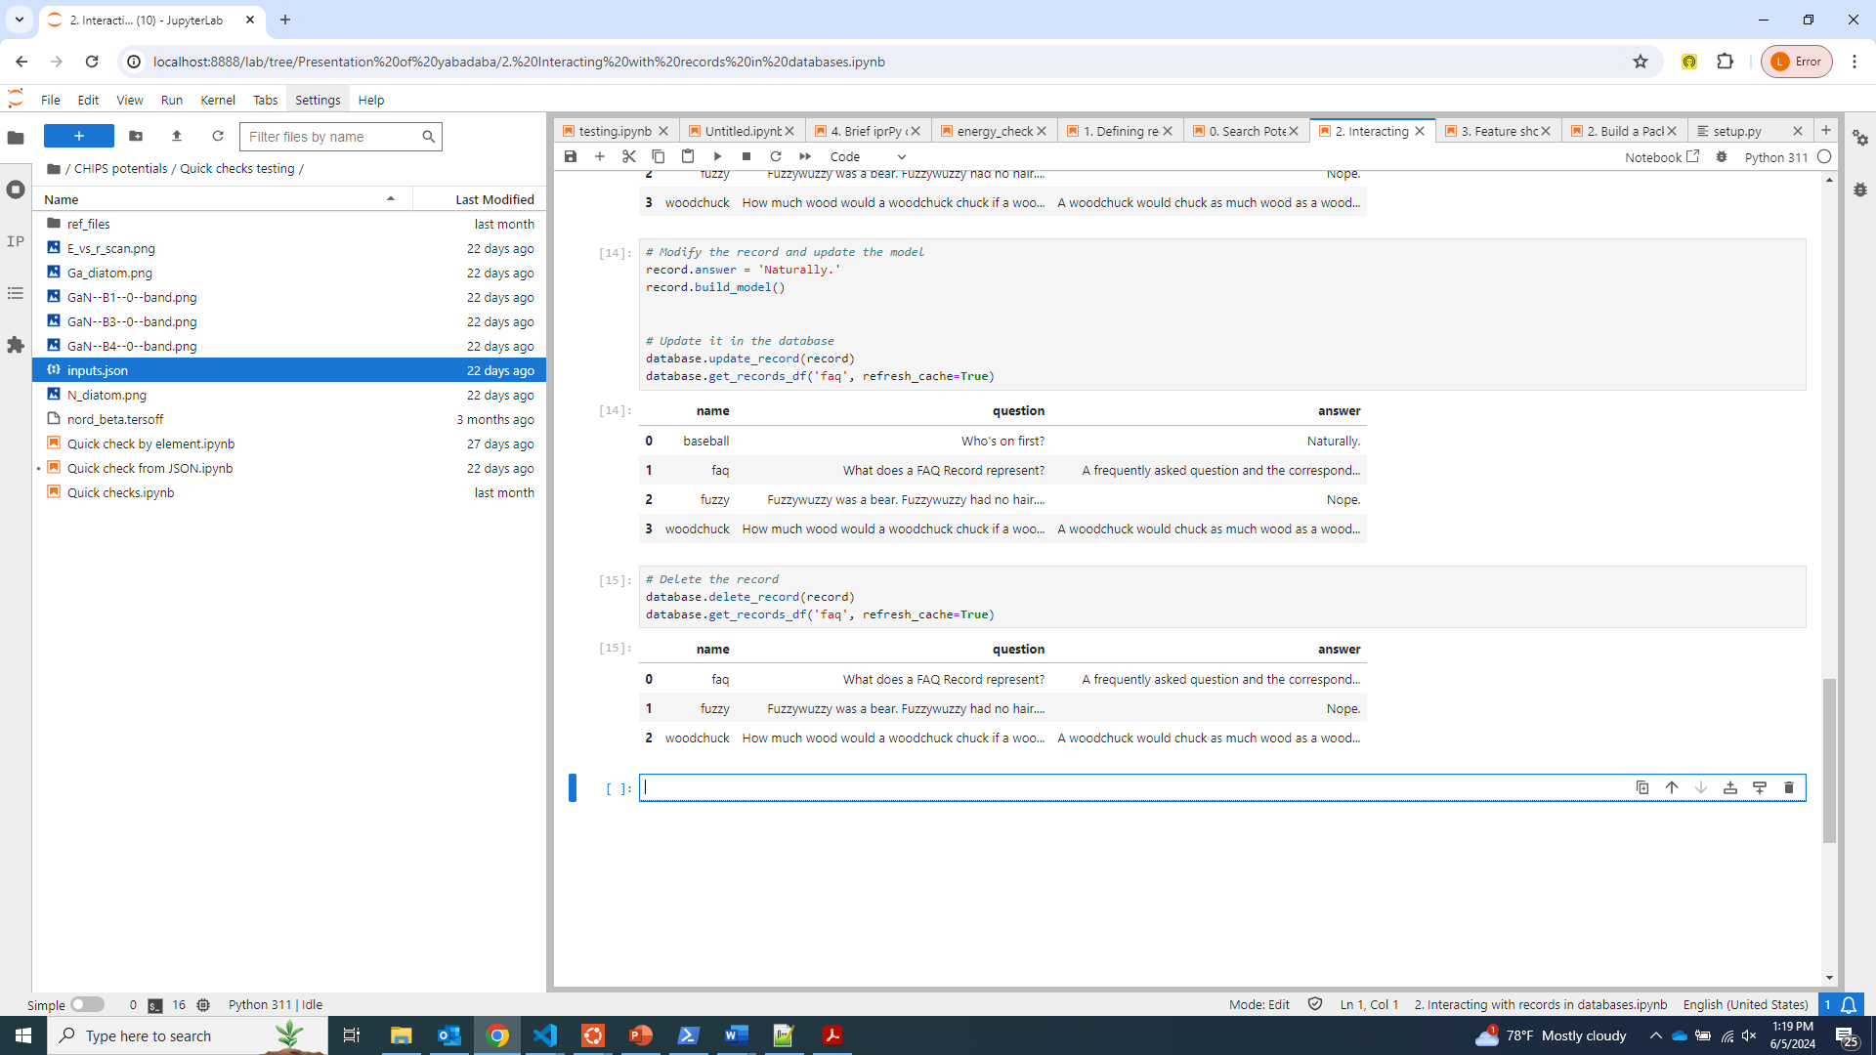
Modifying database record contents

Slide 14
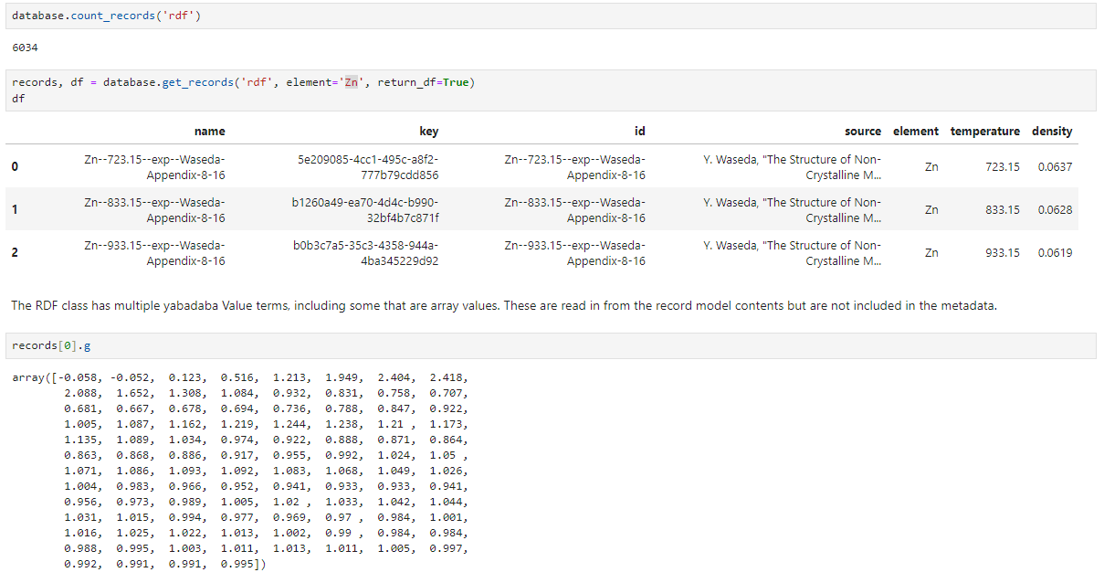
Demonstration: Liquid RDF data

Slide 15
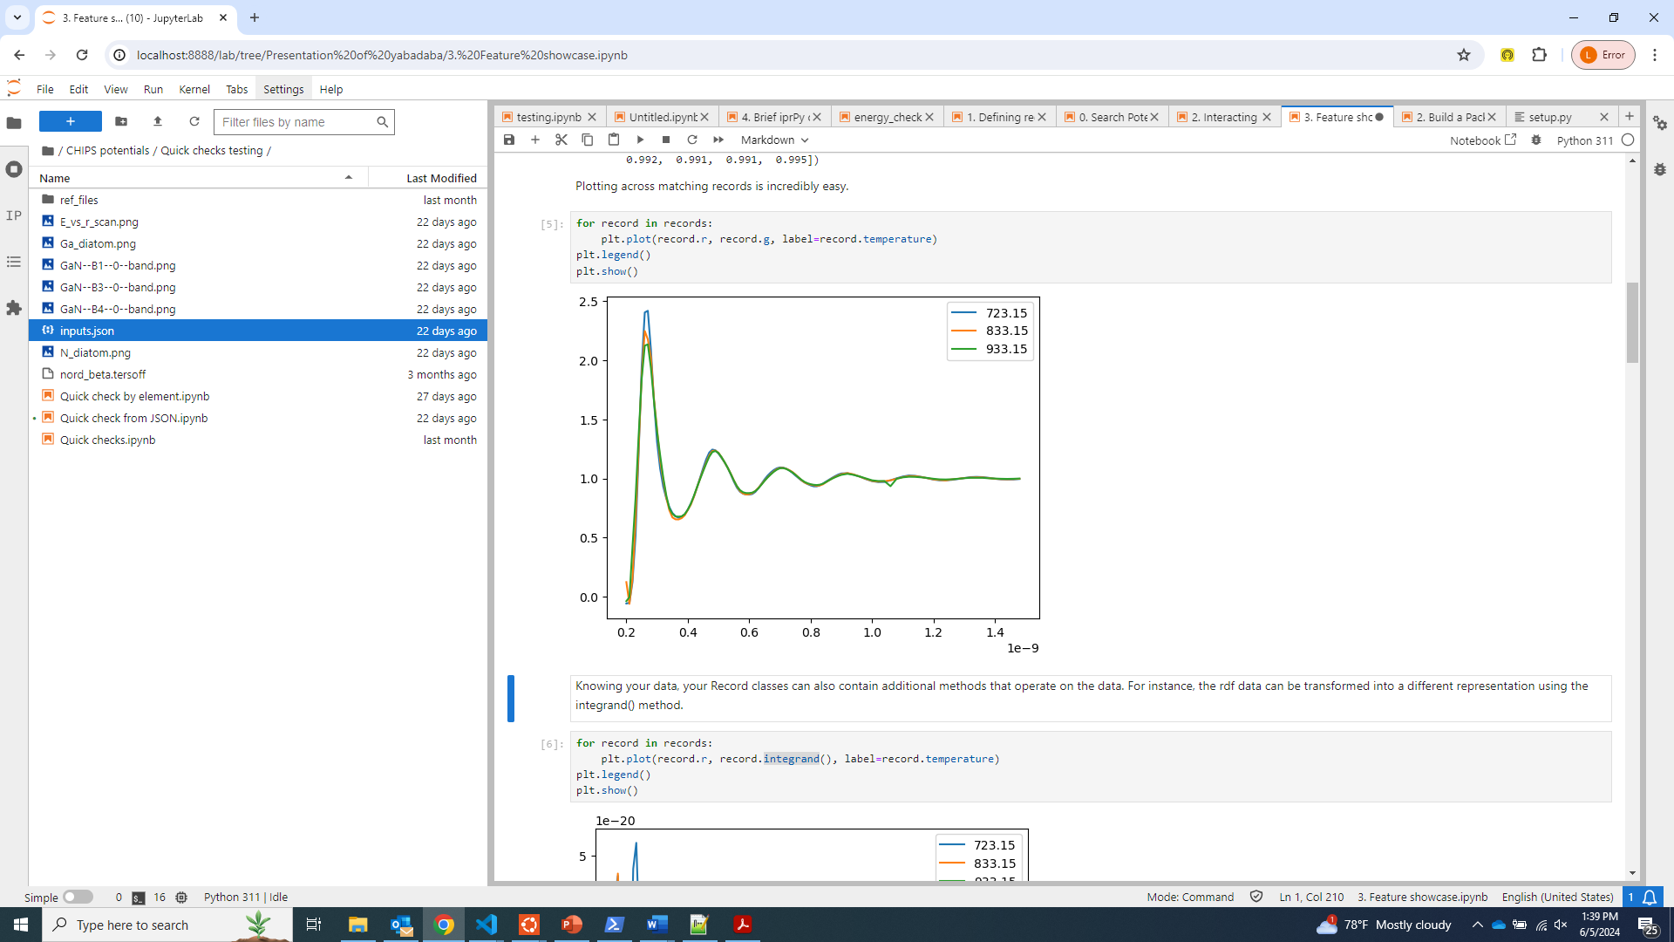
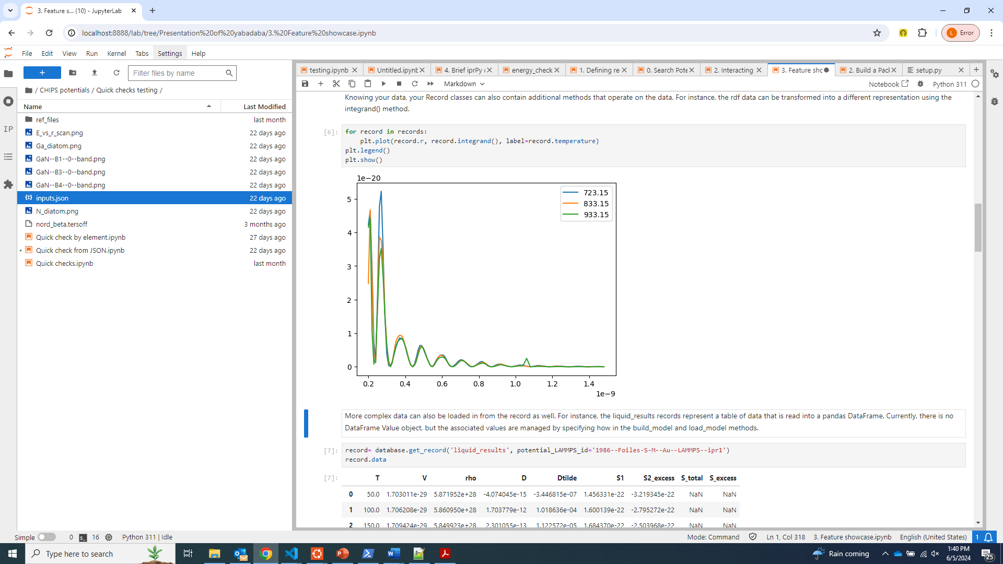
Demonstration: Liquid RDF data
g is the data itself
integrand() is g transformed

Slide 16
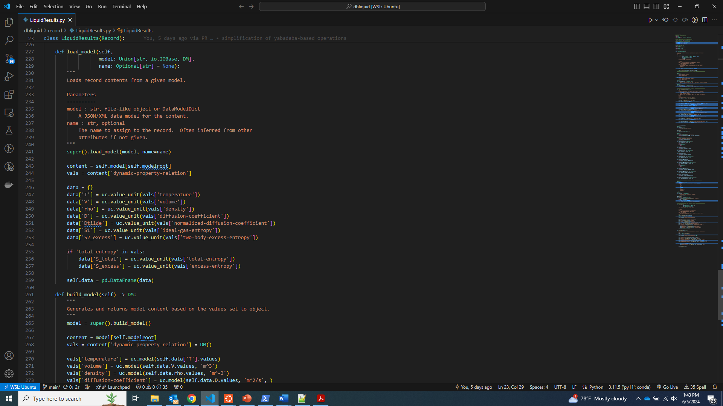
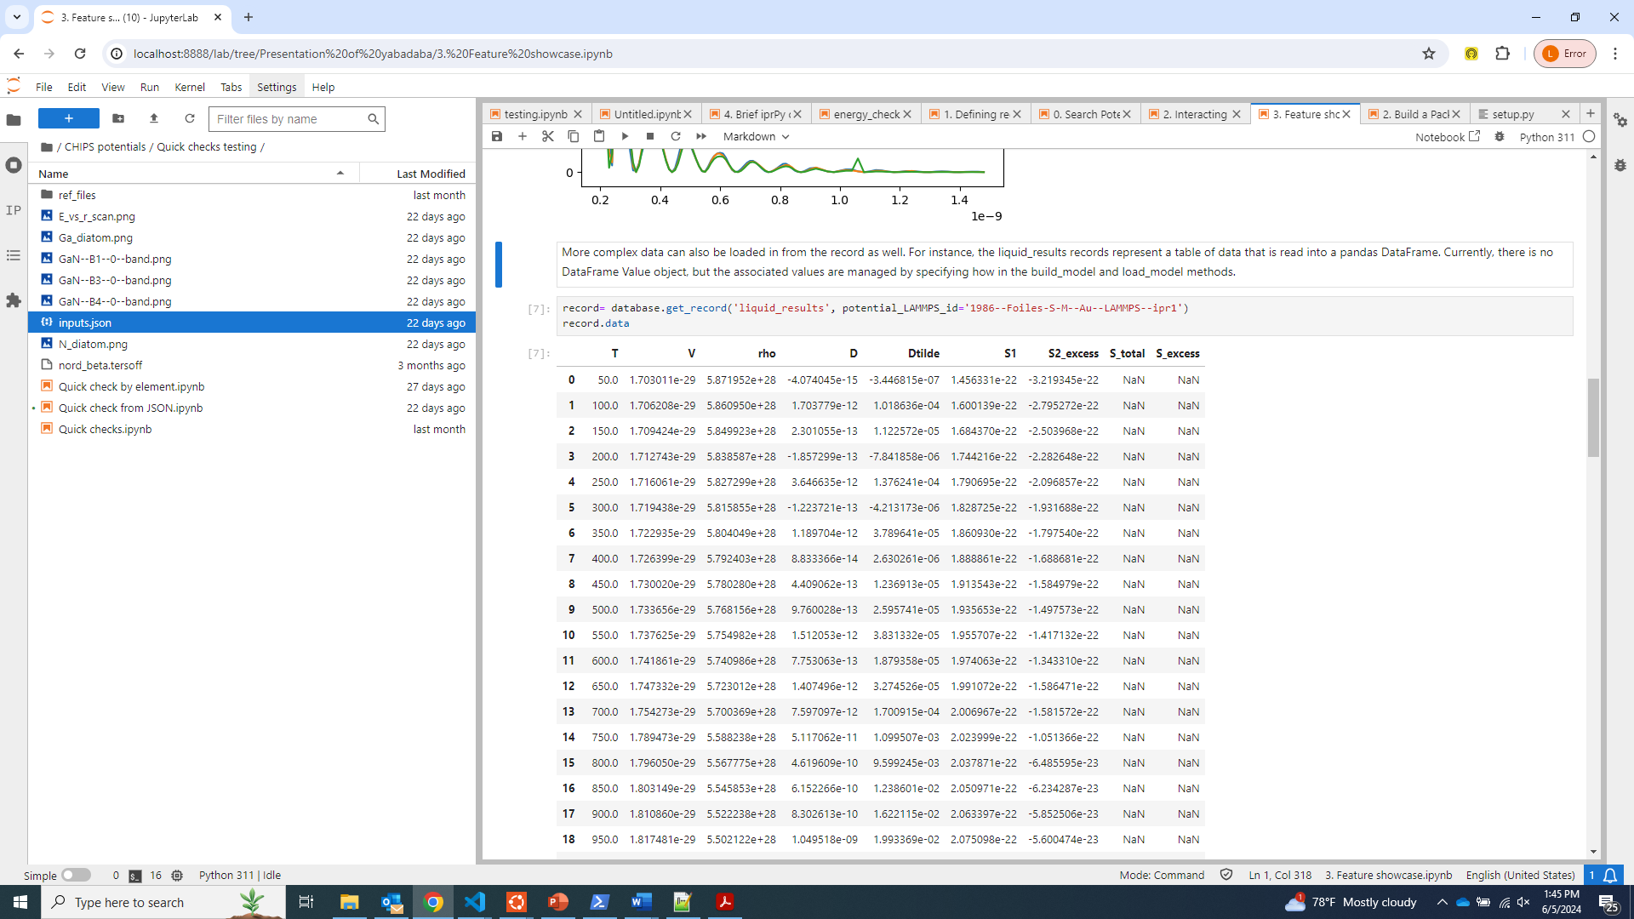
Load DataFrame data from a record
No DataFrameValue (yet), but can directly define load_model() and build_model() operations

Slide 17
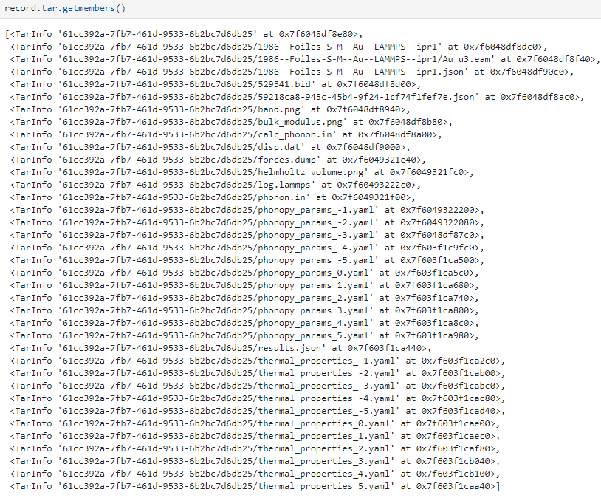
Each record entry can have a tar folder
Database methods
get_tar(), add_tar(), update_tar(), delete_tar()
Record attributes
Record.database points to database record came from
Record.tar is TarFile of that record’s tar in ‘r’ mode

Slide 18
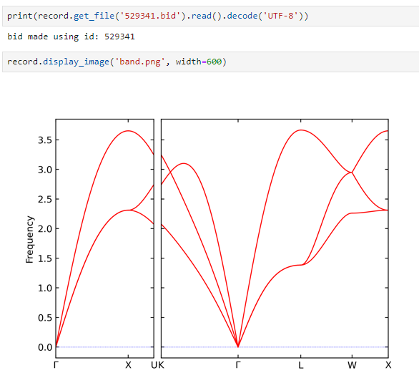
Access file contents from a tar
get_file() returns open file object from tar
display_image() gets and displays image from tar

Slide 19
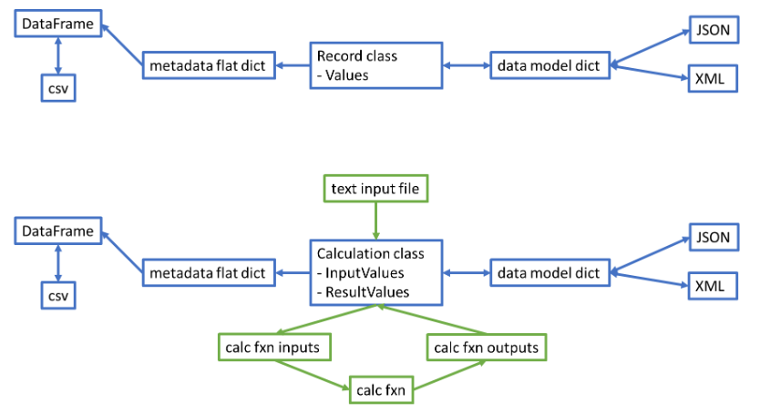
Extending yabadaba to iprPy

Slide 20
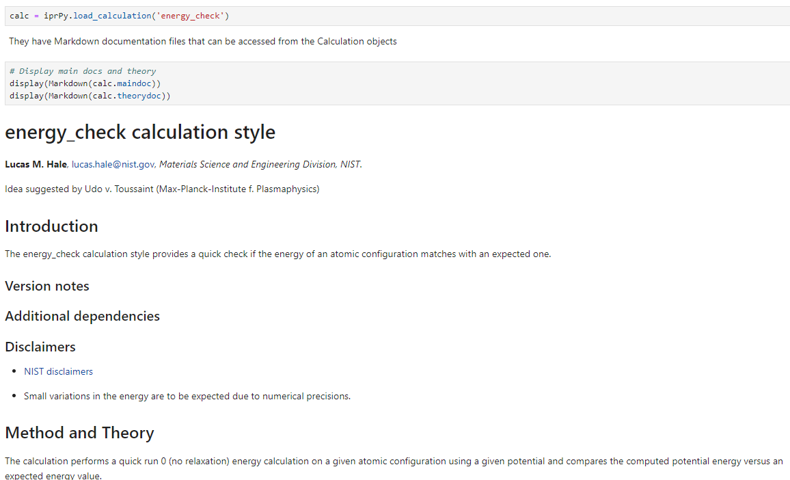

Slide 21
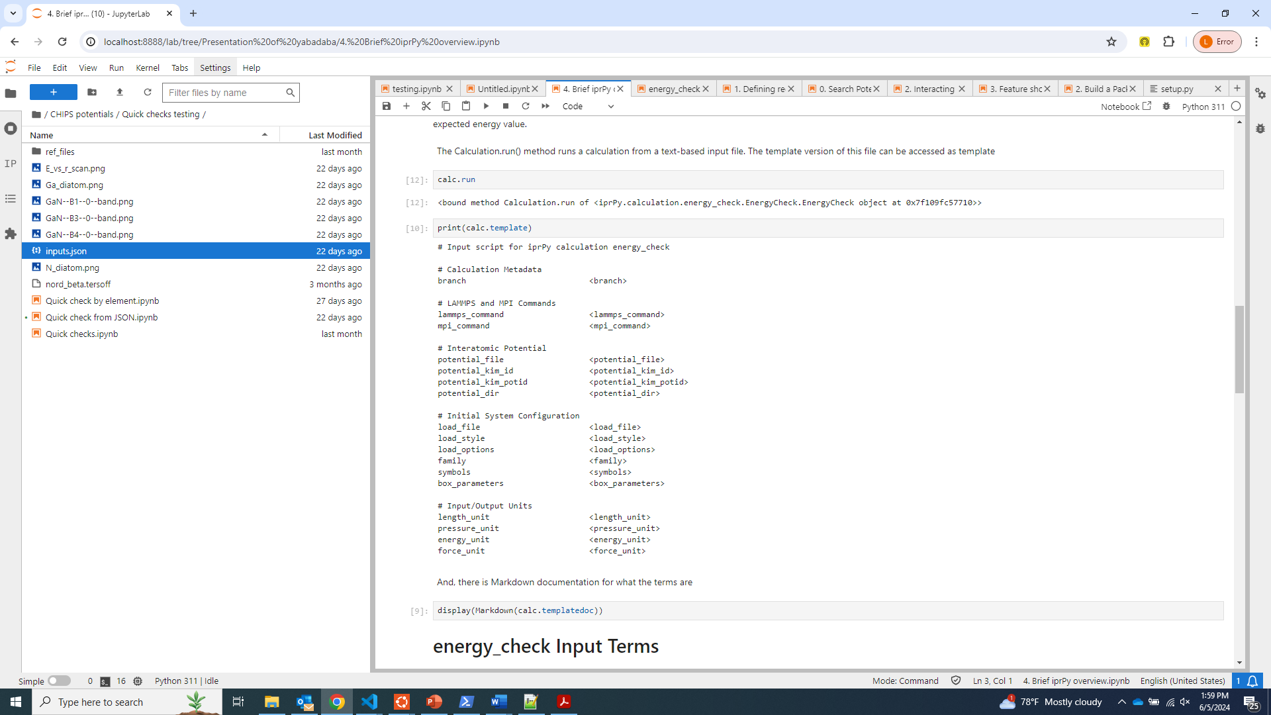
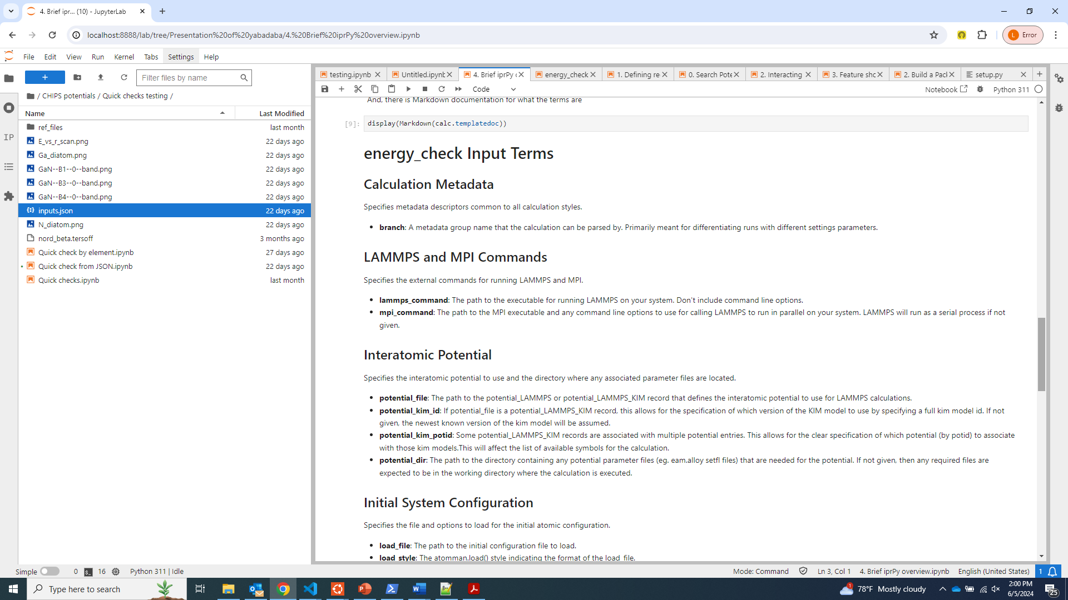
Run a calculation from an input file

Slide 22
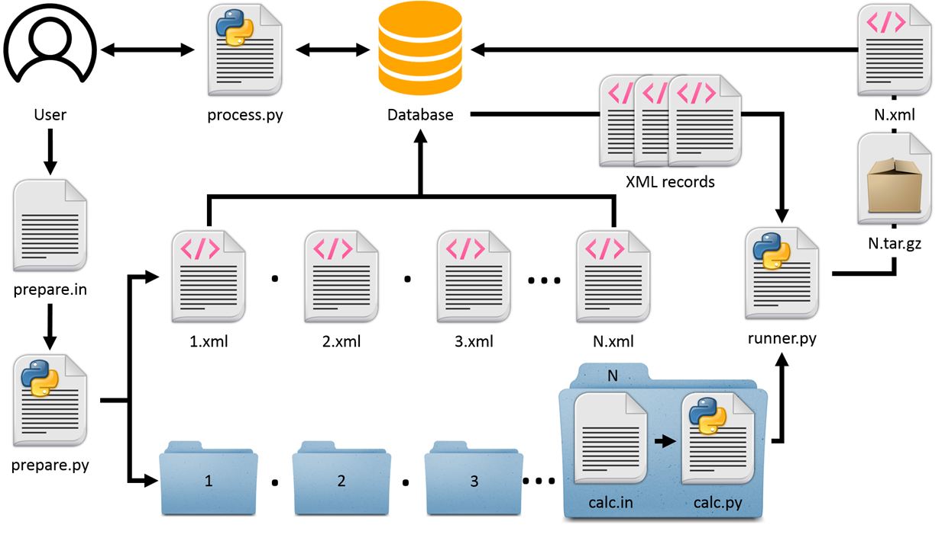
General high throughput design
Prepare generates all new combos of input values
Input file in unique local directory
Incomplete record added to database
Runner runs the calculations
Sequentially runs across local inputs
Updates record and uploads tar of generated files
Multiple runners can operate without conflicts
Process results from the database

Slide 23
Prepare concepts
A single calc run takes single values for each input term
Multiple calcs can be prepared by giving lists of values
Record classes collect terms into sets that are iterated together
All meaningful combos are built and validated
Only good and unique combos are used to construct new calc runs
Can define “buildcombos” functions that build input term lists based on other records in the database
Calculation-specific master_prepare() options can be used to define default prepare settings for that calc
(in development) EmperorPrepare classes to automate master_prepare and runner jobs

